Slide 1


Slide 2

N.K SAINI
CEO AND CHIEF TRAINER
Nksaini010@gmail.com
safetyandcare2@gmail.com
261/262, Kakru (Ambala) Haryana - 134007 (INDIA)

Slide 3
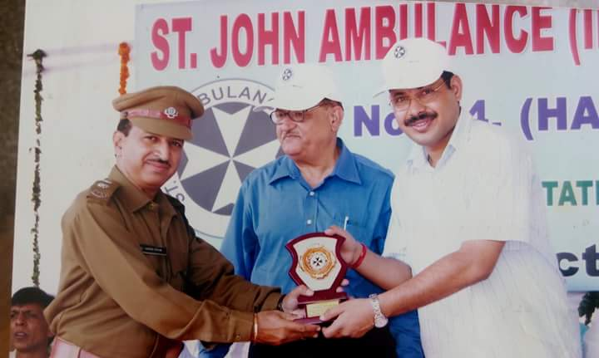
We are authorized to conduct Training Sessions for Red Cross & St John Ambulance Certification

Slide 4
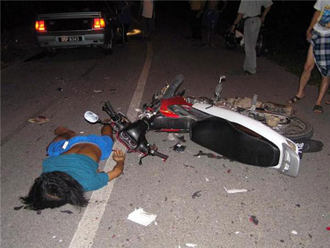
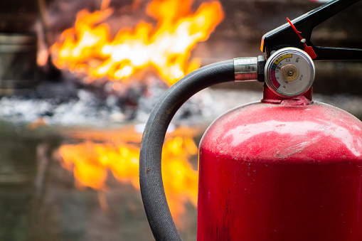
OUR TRAININGS
FIRST AID
FIRE SAFETY

Slide 5


Defensive Driving
Women Safety

Slide 6
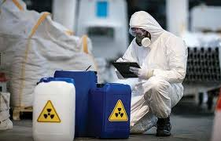
Chemical Safety
We provide Industrial Audits & Other Required Trainings & services

Slide 7
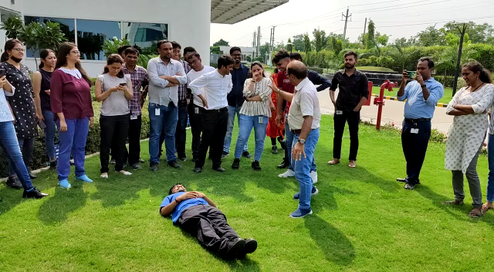
TRAINING PRACTICAL SESSIONS

Slide 8
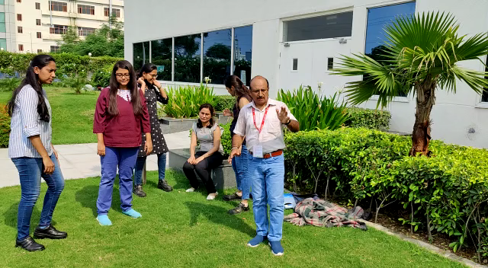
SAFE SHIFT

Slide 9
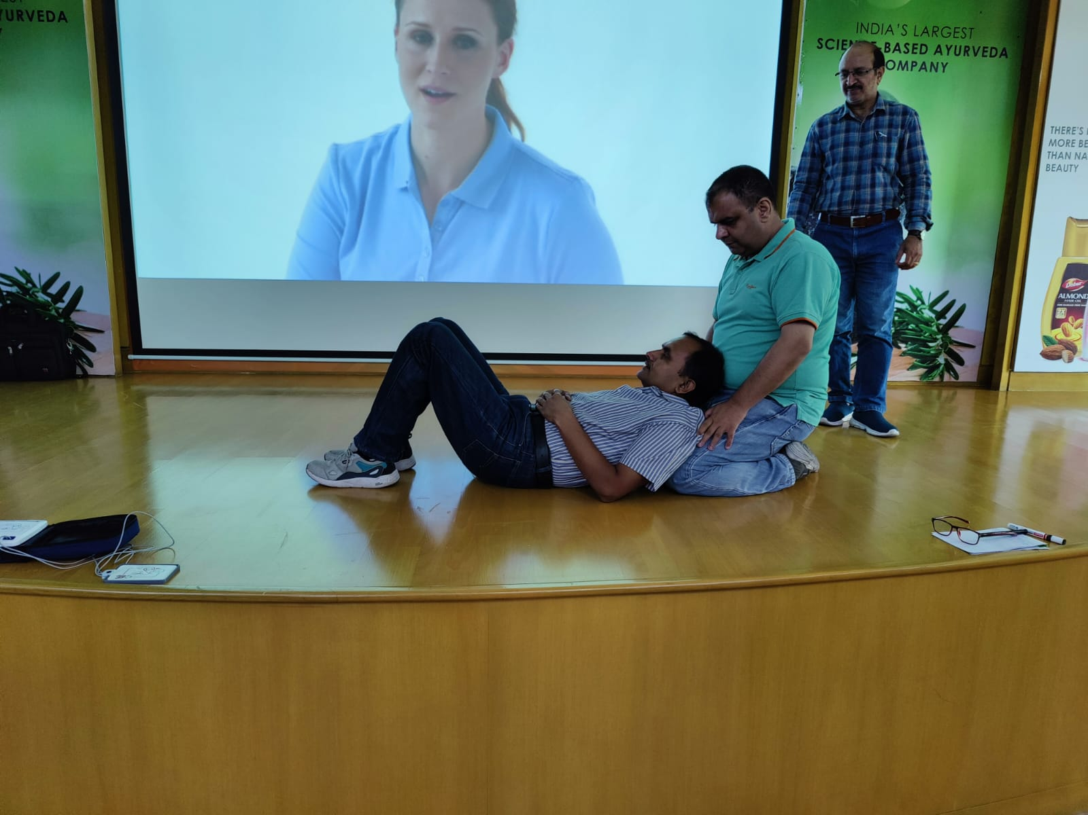

Slide 10
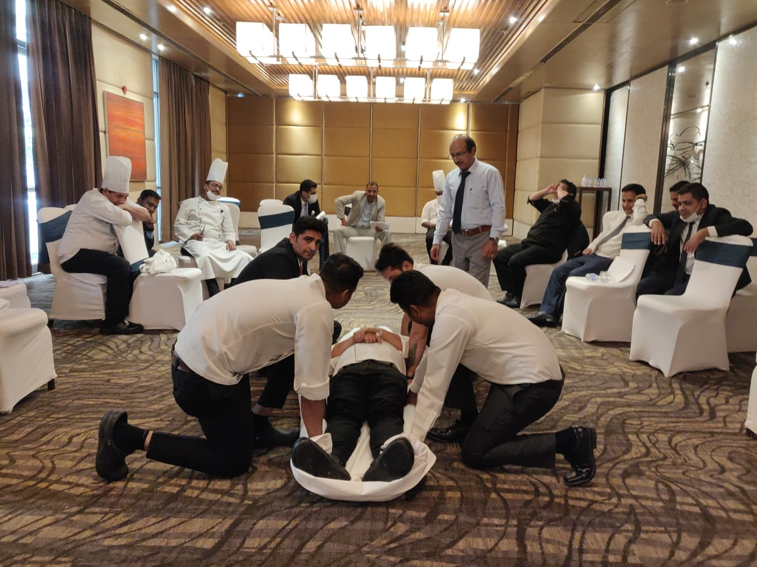

Slide 11
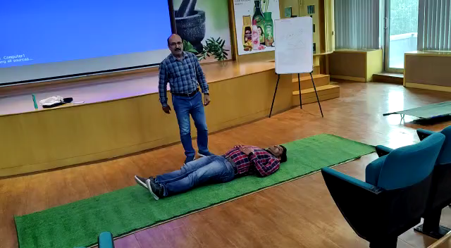

Slide 12
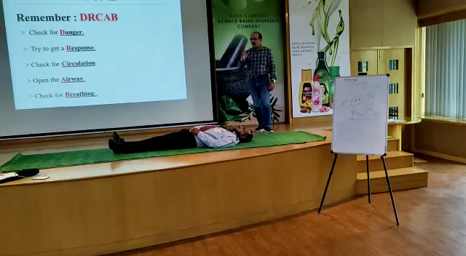

Slide 13
THANKS

